Slide 1


AegisIQ
AI-Powered Infrastructure Decision Intelligence Platform
Tagline: Predict. Simulate. Protect.
Team ID: H26DIS12
Team Leader:Sabariswaran M
Team Members:
Sathyaraj K ,Sabariswaran M Sridhar V
College: Mangayarkarasi College of Engineering

Slide 2
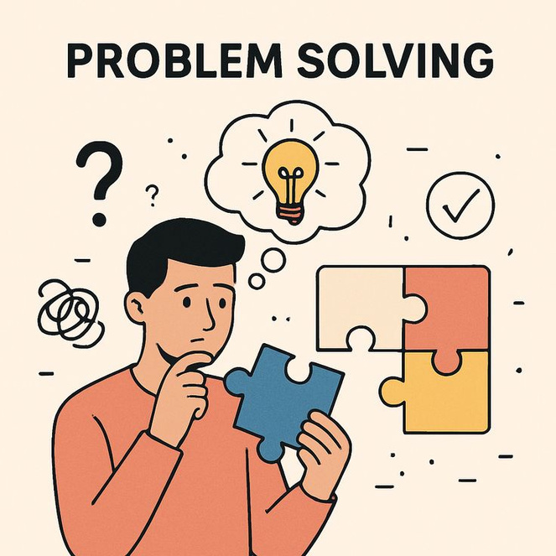

Problem Statement
Infrastructure changes are often deployed without understanding their impact, and existing tools detect failures only after deployment, leading to downtime and business disruption.
Objective
To predict deployment risks before production using simulation and intelligent deployment recommendations.

Slide 3
System Design
High-Level Architecture
USER
HTML • CSS • JavaScript
(Web Dashboard)
Spring Boot REST API
Decision Twin Blast Radius Risk Engine
Simulation Analysis (Rule-Based)
└──────────────────────────────┘
Recommendation Engine
PostgreSQL Database
Deployment Decision Output

Slide 4
Algorithm Rule:Based Risk Analysis
AegisIQ Workflow
Start
Select Infrastructure Change
Decision Twin Simulation
Depenetence analaysis
Risk Calculation
Generate Recommendation
Deploy / Stop

Slide 5



Technology Stack
Frontend
Backend
Tools
HTML
CSS
JavaScript
Spring Boot
REST API
Database
PostgreSQL
STS (Spring Tool Suite)
VS Code

Slide 6
Results & Demo
Current Progress
Demo Flow
✅ Project UI Completed
✅ Dashboard Developed
✅ Decision Twin Workflow Designed
✅ Spring Boot Backend Created
✅ PostgreSQL Connected
✅ Rule-Based Risk Analysis Implemented
Database Upgrade
↓
Decision Twin Simulation
↓
Blast Radius Analysis
↓
Risk Score Generation
↓
Deployment Recommendation

Slide 7
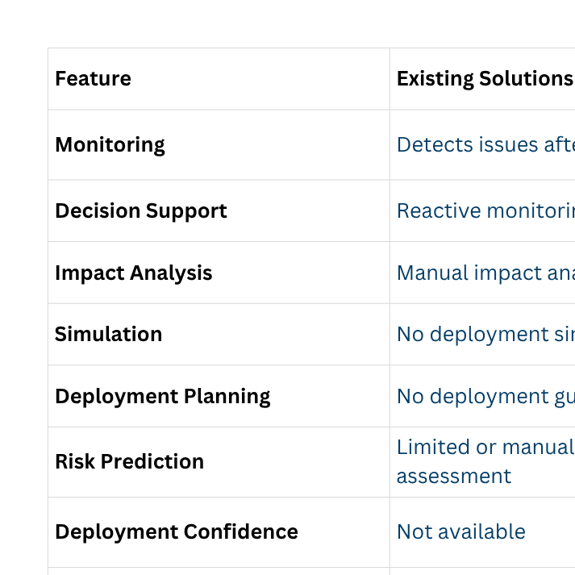
Comparison with Existing Solutions
Existing Solutions AegisIQ

Slide 8
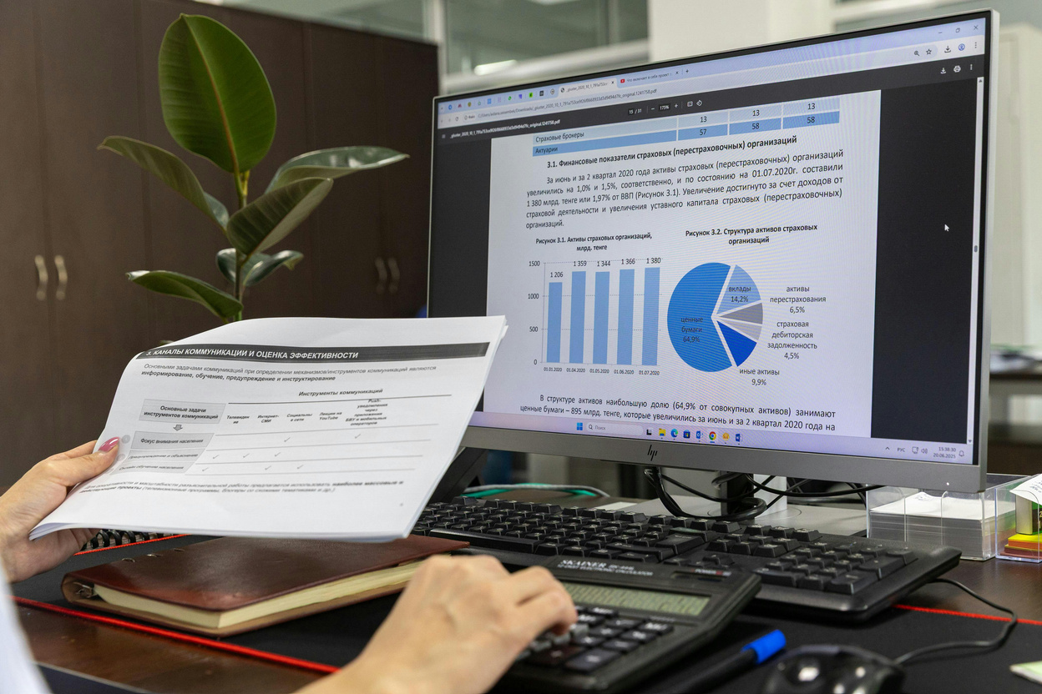
Summary & Future Work
Summary
Simulates infrastructure changes before deployment.
Predicts deployment risks.
Identifies affected services.
Provides safer deployment recommendations.
Helps reduce downtime and business impact.
Future Work
Machine Learning-based Risk Prediction
Kubernetes Integration
Multi-Cloud Support
AI Chat Assistant
Automatic Rollback
Self-Healing Infrastructure
Tagline
Predict. Simulate. Protect.

Slide 9
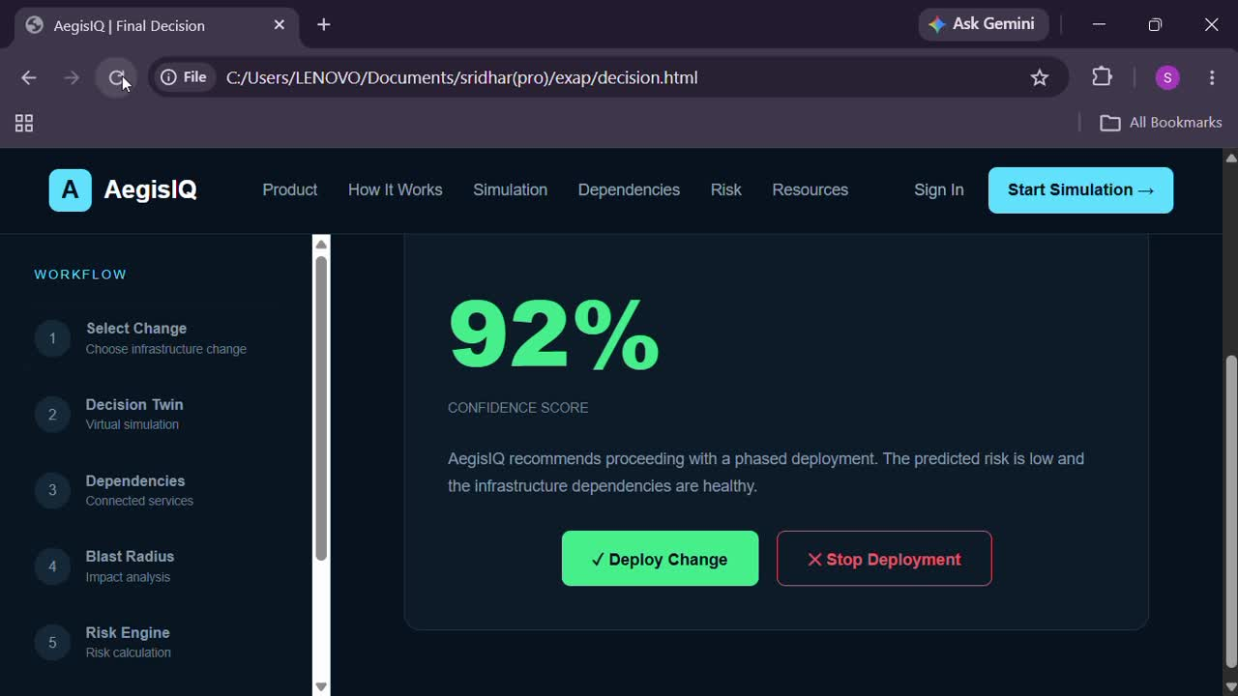
Demo video

Slide 10
Thank You
By AgeeisIQ

